Slide 2
Presentation Outline
Introduction
Background | Problem Statement | Objectives | Justification
Literature review.
Existing technologies | Related works | Gaps
Methodology
Designs.
Results
Final Assembly | Budget
Notes:
10/13/2020
2

Slide 3
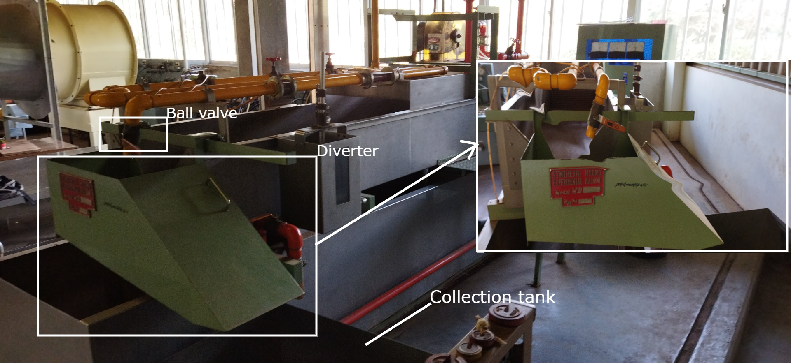
Synthetic Hydro-Experimental Machine
Notes:
Our project is based on the synthetic hydro-experimental machine currently present in JKUAT Fluid lab shown in the slide.

Slide 4
Introduction: Background
Background
Fluid flow measurement
- Quantifying a property of an uninterrupted flow.
Flow meters
- Turbine flow meter, rotameter, venturi, and orifice.
- Bernoulli’s Theorem.
Synthetic Hydro-Experimental Machine
- Consists of venturi, and orifice
- Establishing a relationship between discharge, differential pressure, and the coefficient of discharge.
Notes:
This project considers an experiment to determine the coefficient of discharge of a Venturimeter.

Slide 5
Introduction: Problem Statement
Ideal
Fluid flow experiments require one to synchronize discharge collection with time and temperature measurement.
Current State
- Determination of steps based on human intuition.
Discharge collection synchronization by a minimum of two operators.
Results outside the tolerable range.
Automated Synthetic Hydro-Experimental machine
Precise discharge flow control.
Automated discharge collection.
Automate discharge weight and temperature measurement.

Slide 6
Introduction: Objectives
Main Objective
To automate the discharge collection process of the Synthetic Hydro-Experimental Machine.
Specific Objectives
To design an automated discharge flow control unit that can turn the ball valve in steps of less than 1⁰ and divert the flow in less than 1 second.
2. To design and fabricate a discharge handling unit with automated weight, time, and temperature measurements, and a discharge collection tank that can discharge in the shortest time possible.
3. To design a graphical user interface and a robust control algorithm to integrate the units

Slide 7
Literature review
Existing Technologies
- Computational fluid dynamics
- ANSYS, SolidWorks, Autodesk CFD,…
- Analytical predictions
- Pure mathematics with Bernoulli’s Equation.
Related Works
- Electromagnetic Actuation
- Automated Water Sampler (A. Odetti, 2019)
- Pneumatic Control
- Cartridge-type pneumatic dispenser(S. Lee, 2009)
Gaps
- Credibility of the experiment.
- Resources
- Error margins

Slide 8
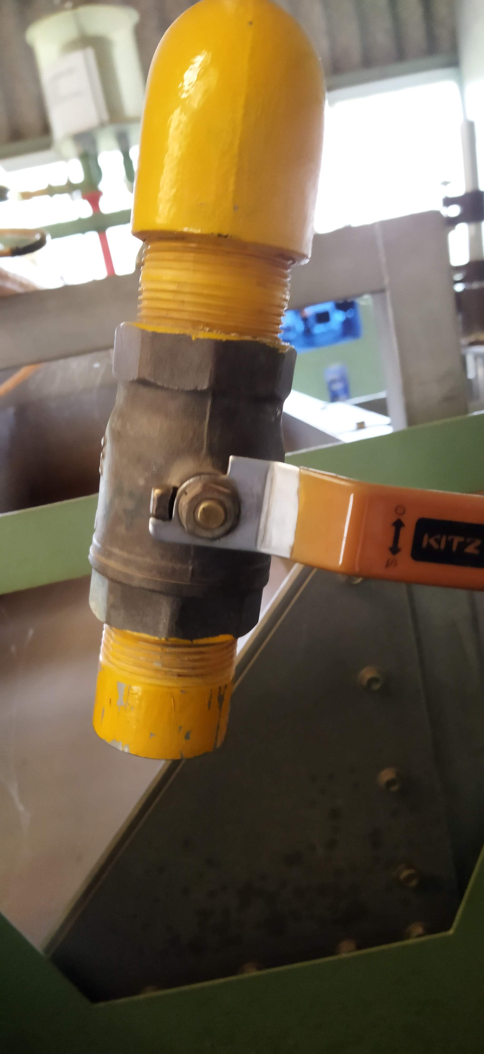
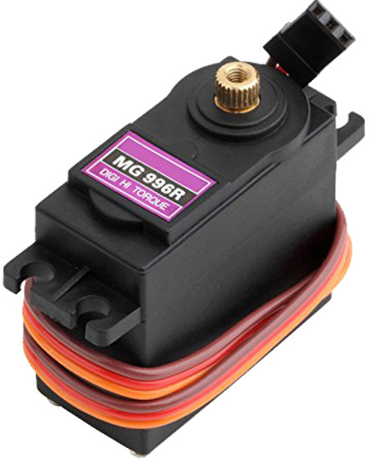
Methodology: Discharge flow control
Flow Control
Requirements: - Utilize the existing ball valve
- Step sizes
- Torque requirement
Selected: MG996R Servo Motor
Justification
Smaller angles less than 1⁰
can be achieved by writing smaller pulse widths.
Considerations
Stepper Motors
Micro-step driver.
Typically 1.8⁰ and sometimes 0.9⁰
Low-speed application < 1500rpm
Servo Motors
Optional driver
Smaller angles, typically 1⁰
High-speed application > 1500rpm
Holding the servo motor in place
Considerations
Shape of the motor.
Motor position when powered.
Requirements
Motor’s zero position when powered = Ball valve’s closed position.
Manual re-alignment.

Slide 9
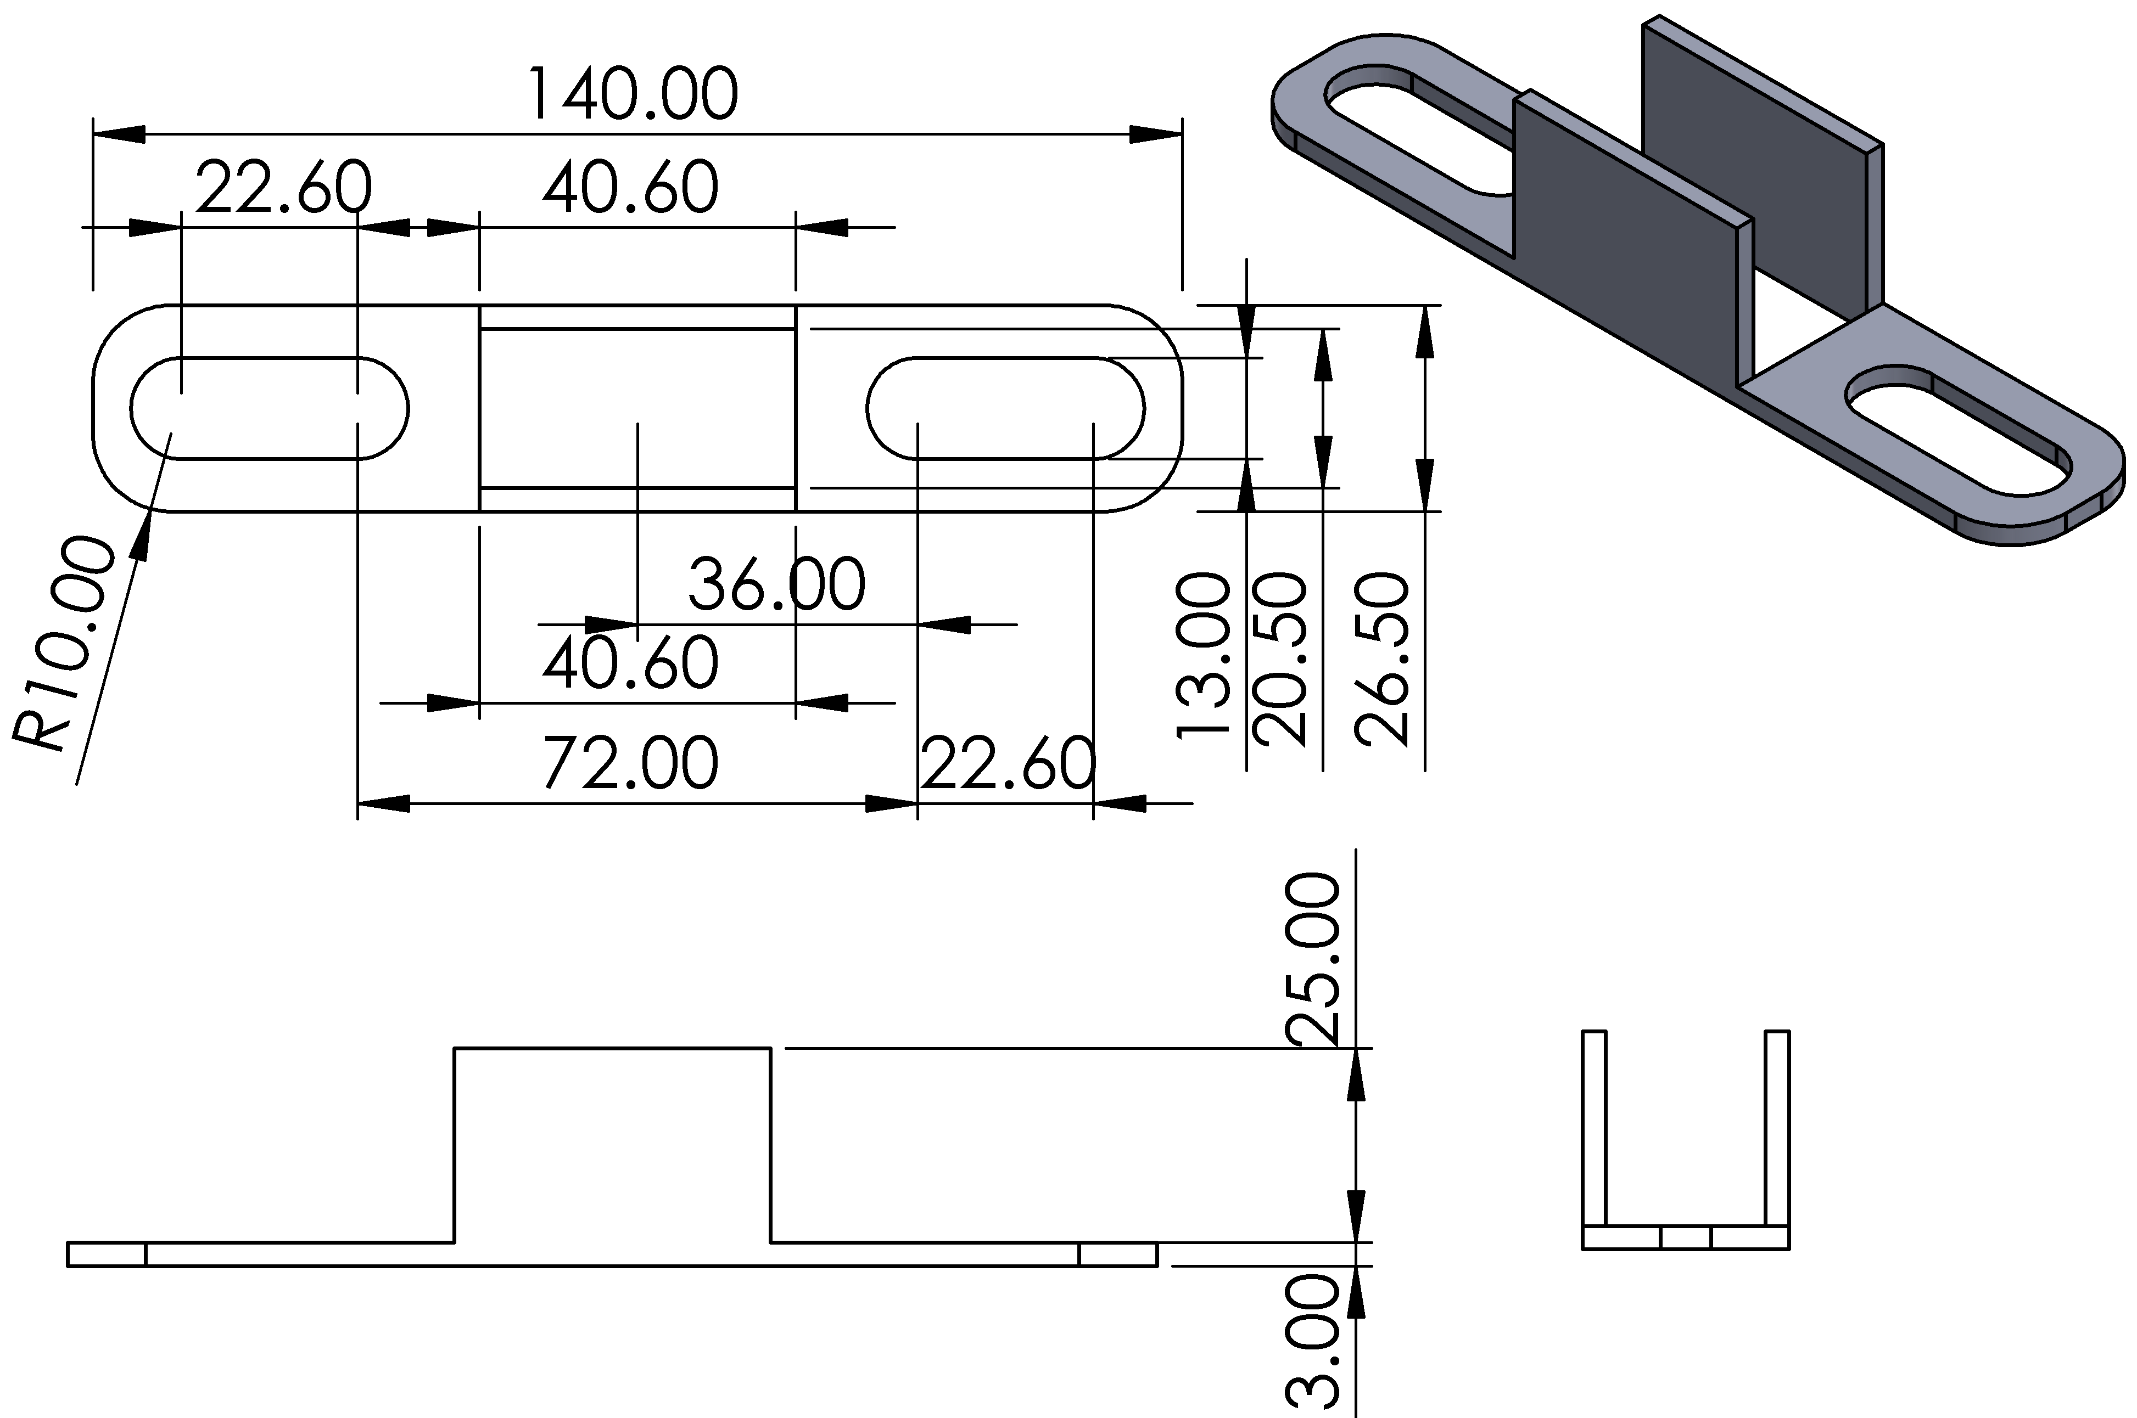
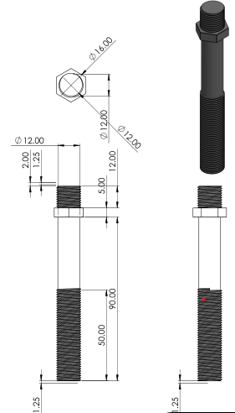
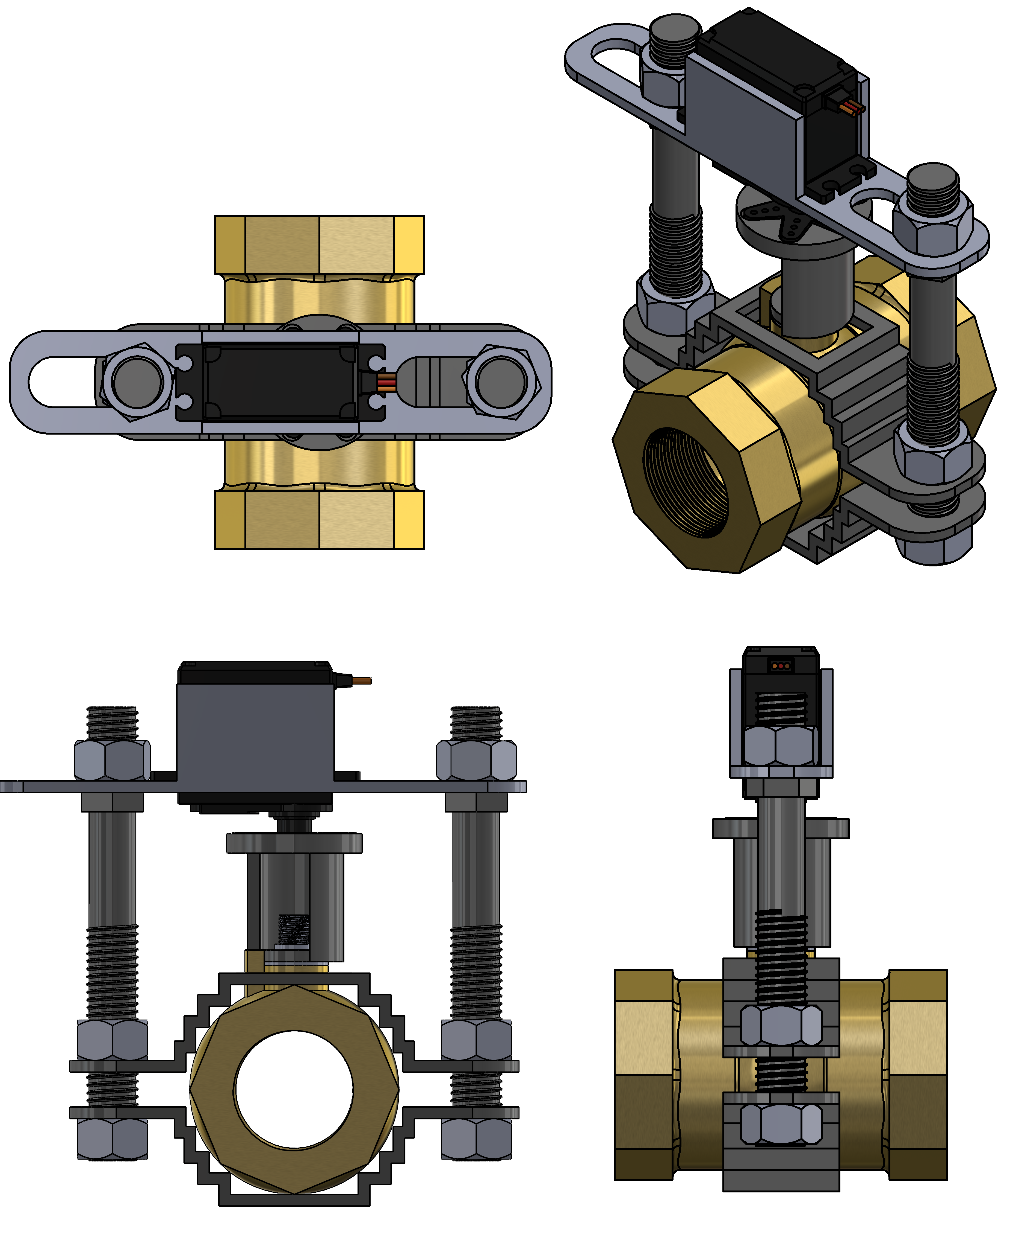
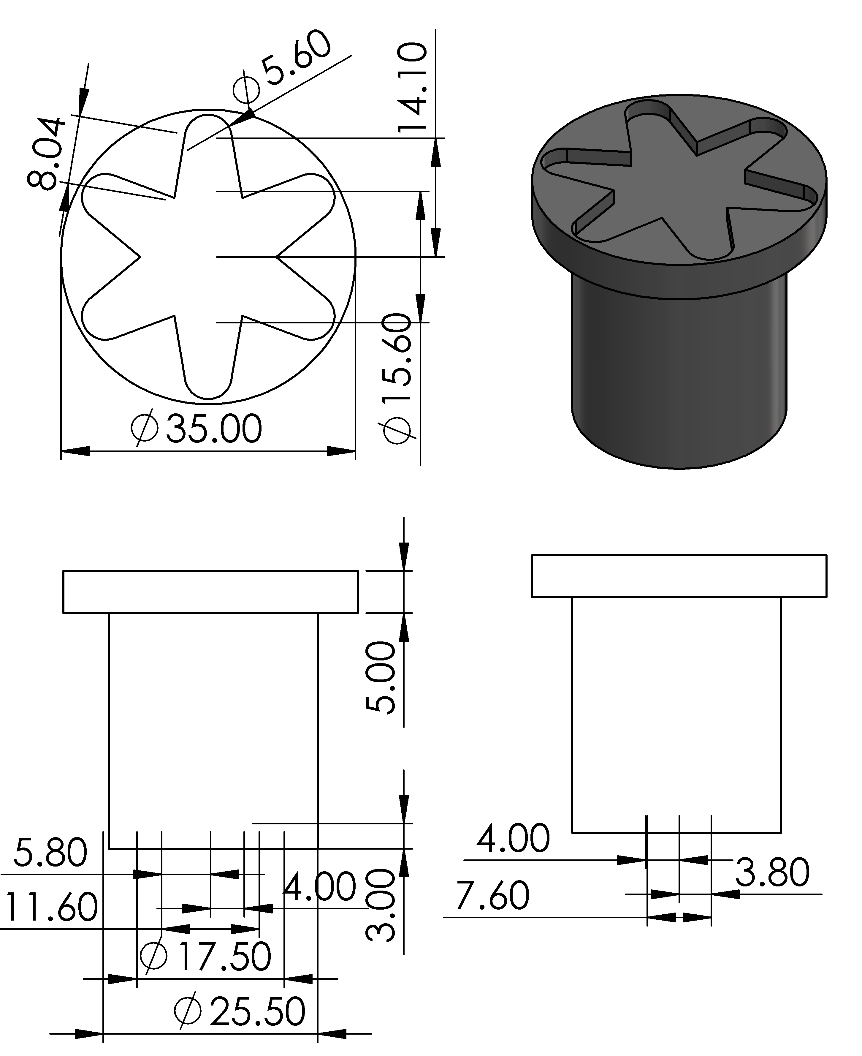
Methodology: Discharge flow control
Motor Cage
Mounting rods
Assembly
Motor-Valve Interface

Slide 10
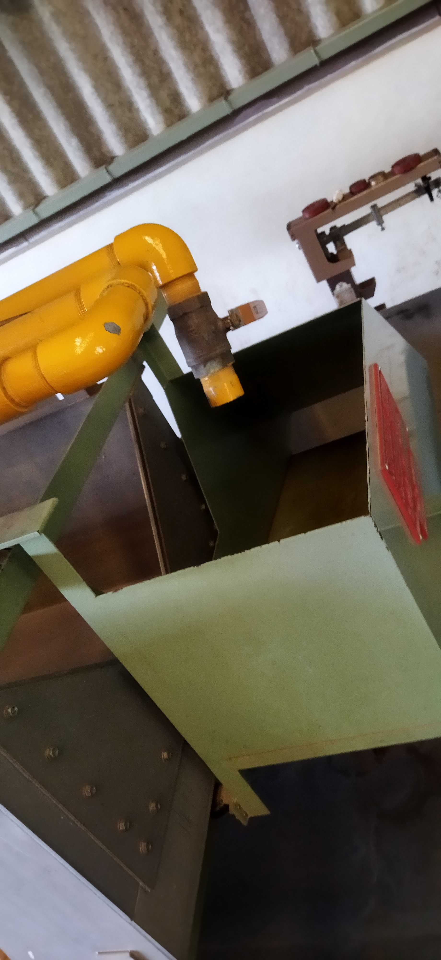
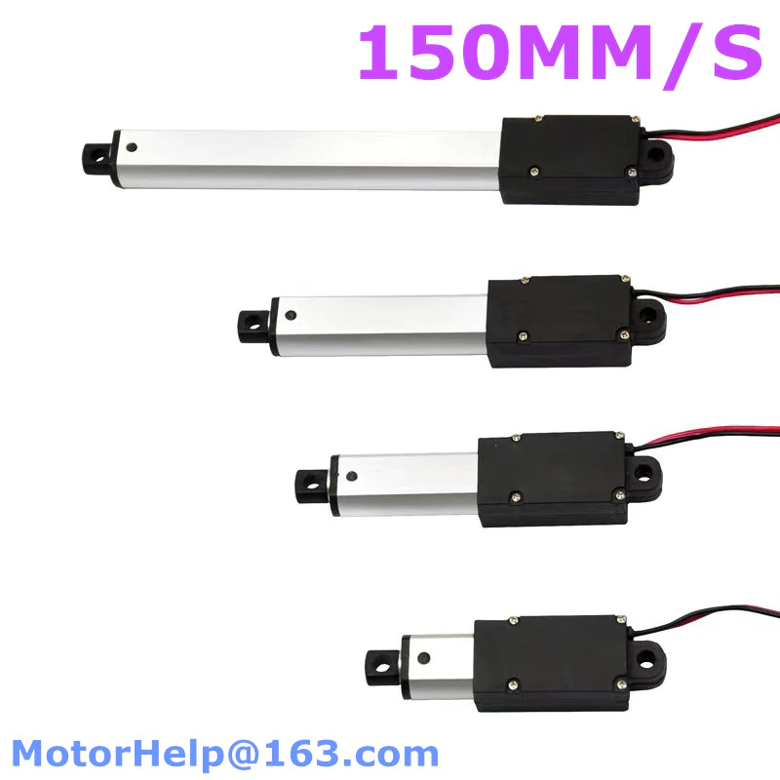
Methodology: Discharge Flow control
Flow Diversion
Requirements: - Response time.
- Force requirement.
Selected: LA-T8 Linear Actuator
Justification
Direct linear push and pull motion
Kinematic mechanism to amplify the displacement.
Holding LA-T8 in place
Considerations
Shape of the actuator
Vibrations due to stroke.
Requirements
Flexible coupling with the diversion flap.
Support for the weight of the flap and flowing stream.
Considerations
Electromagnetic Actuator
Linear push and pull.
Strength in a stroke = 5N/10mm
Piezo-electric actuator
Precise and fast.
Expensive.

Slide 11
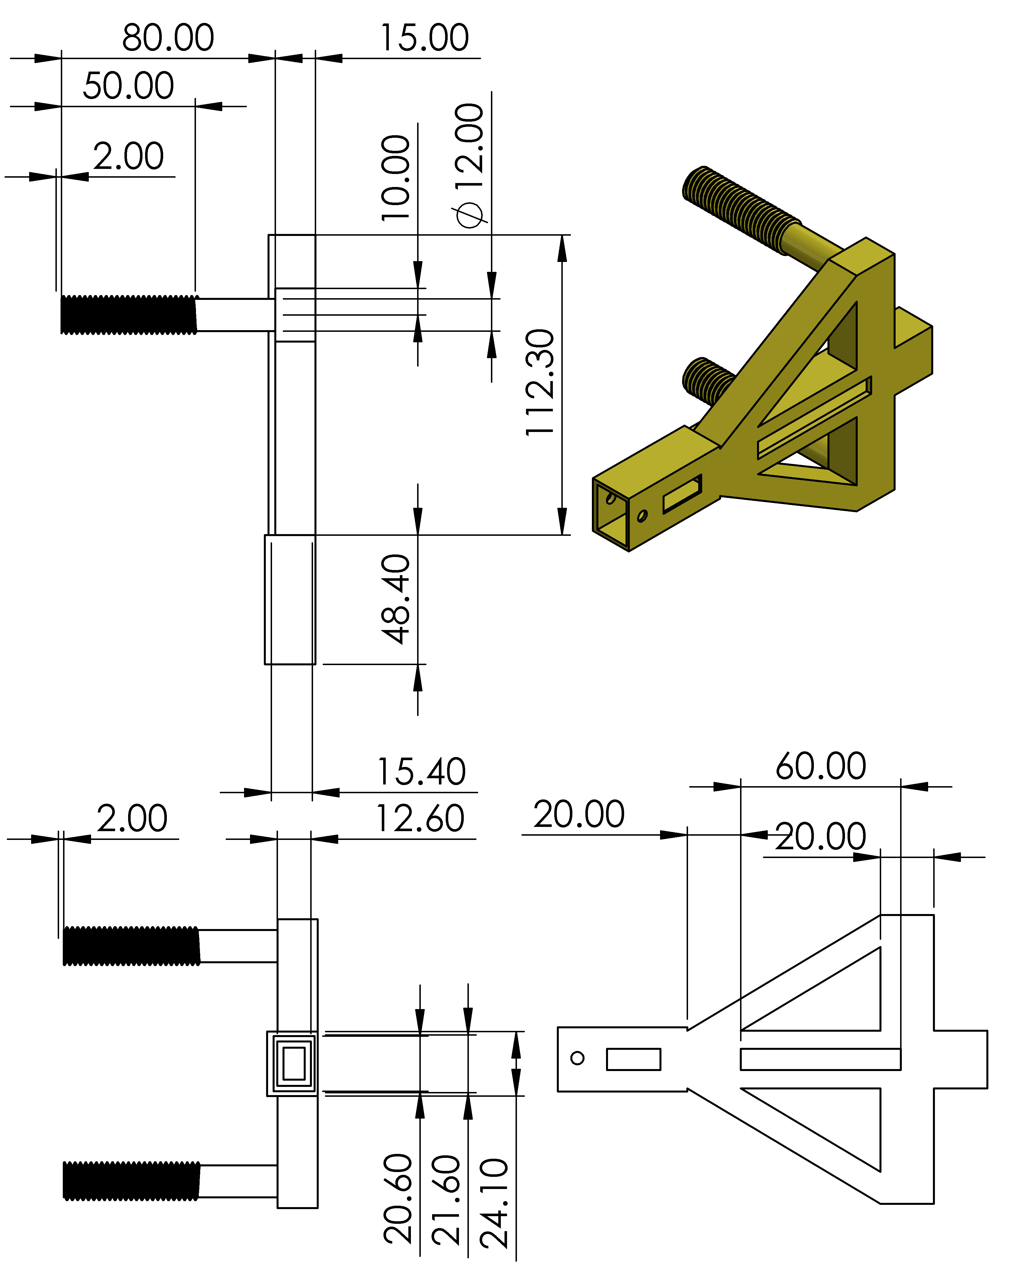
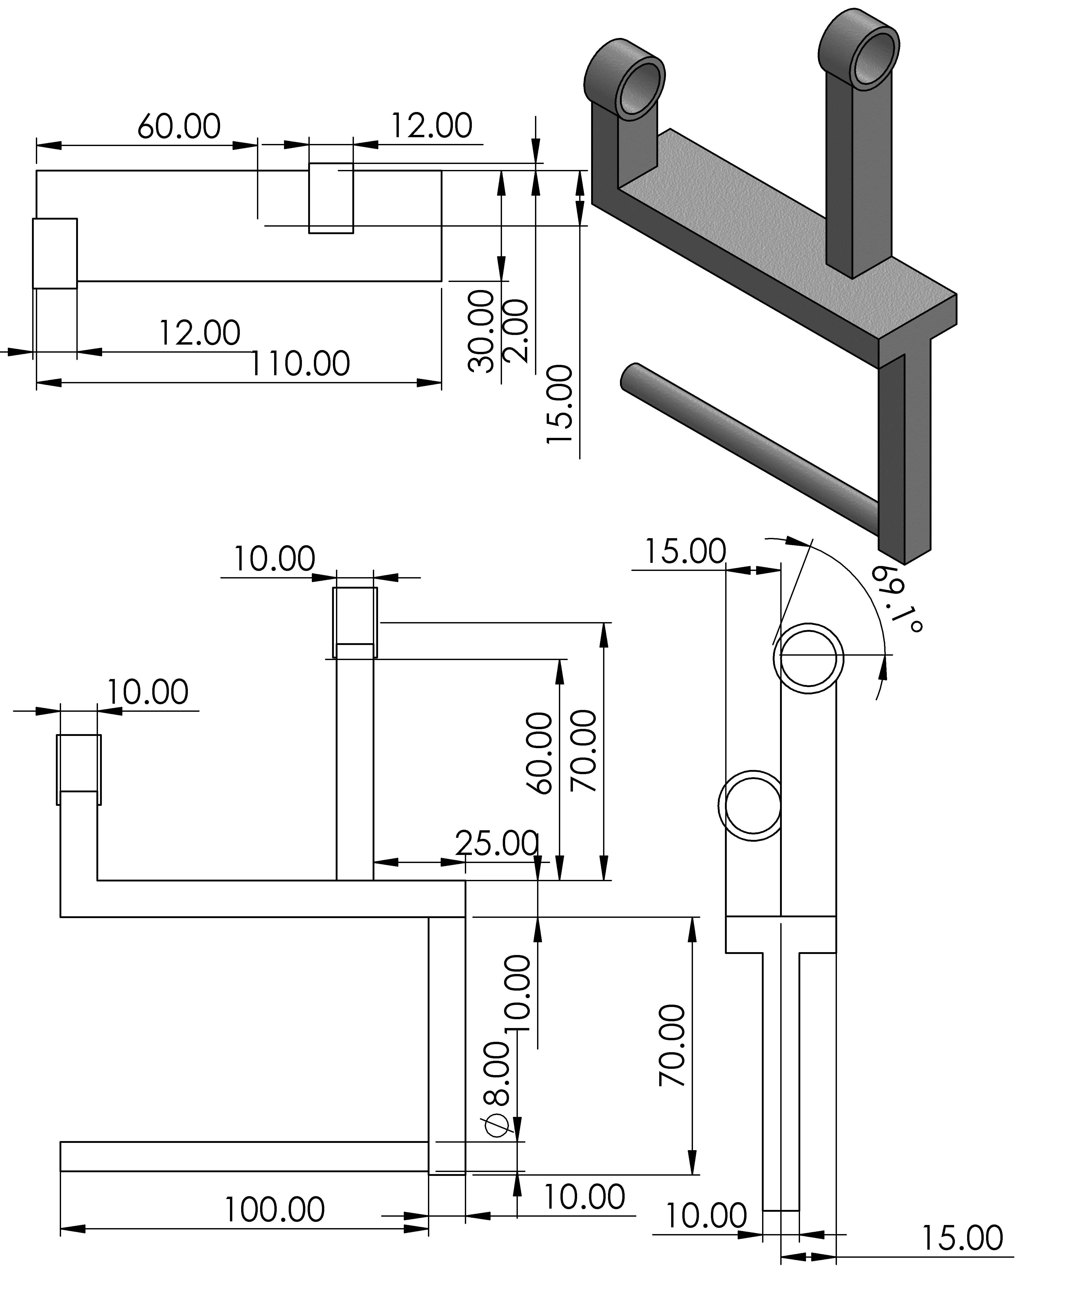
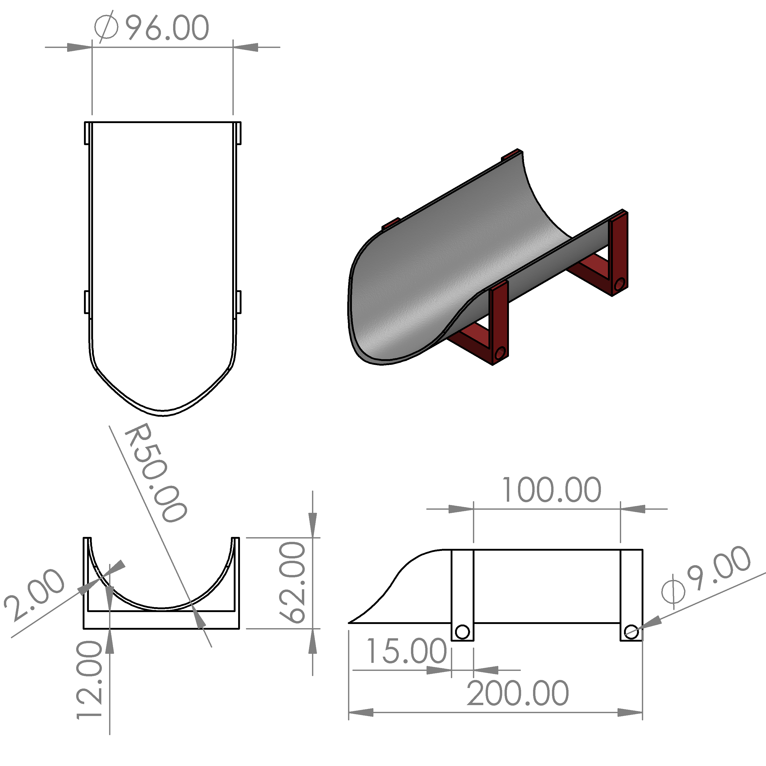
Methodology: Discharge flow control
LA-T8 Holder
Diversion support frame
Flap

Slide 12
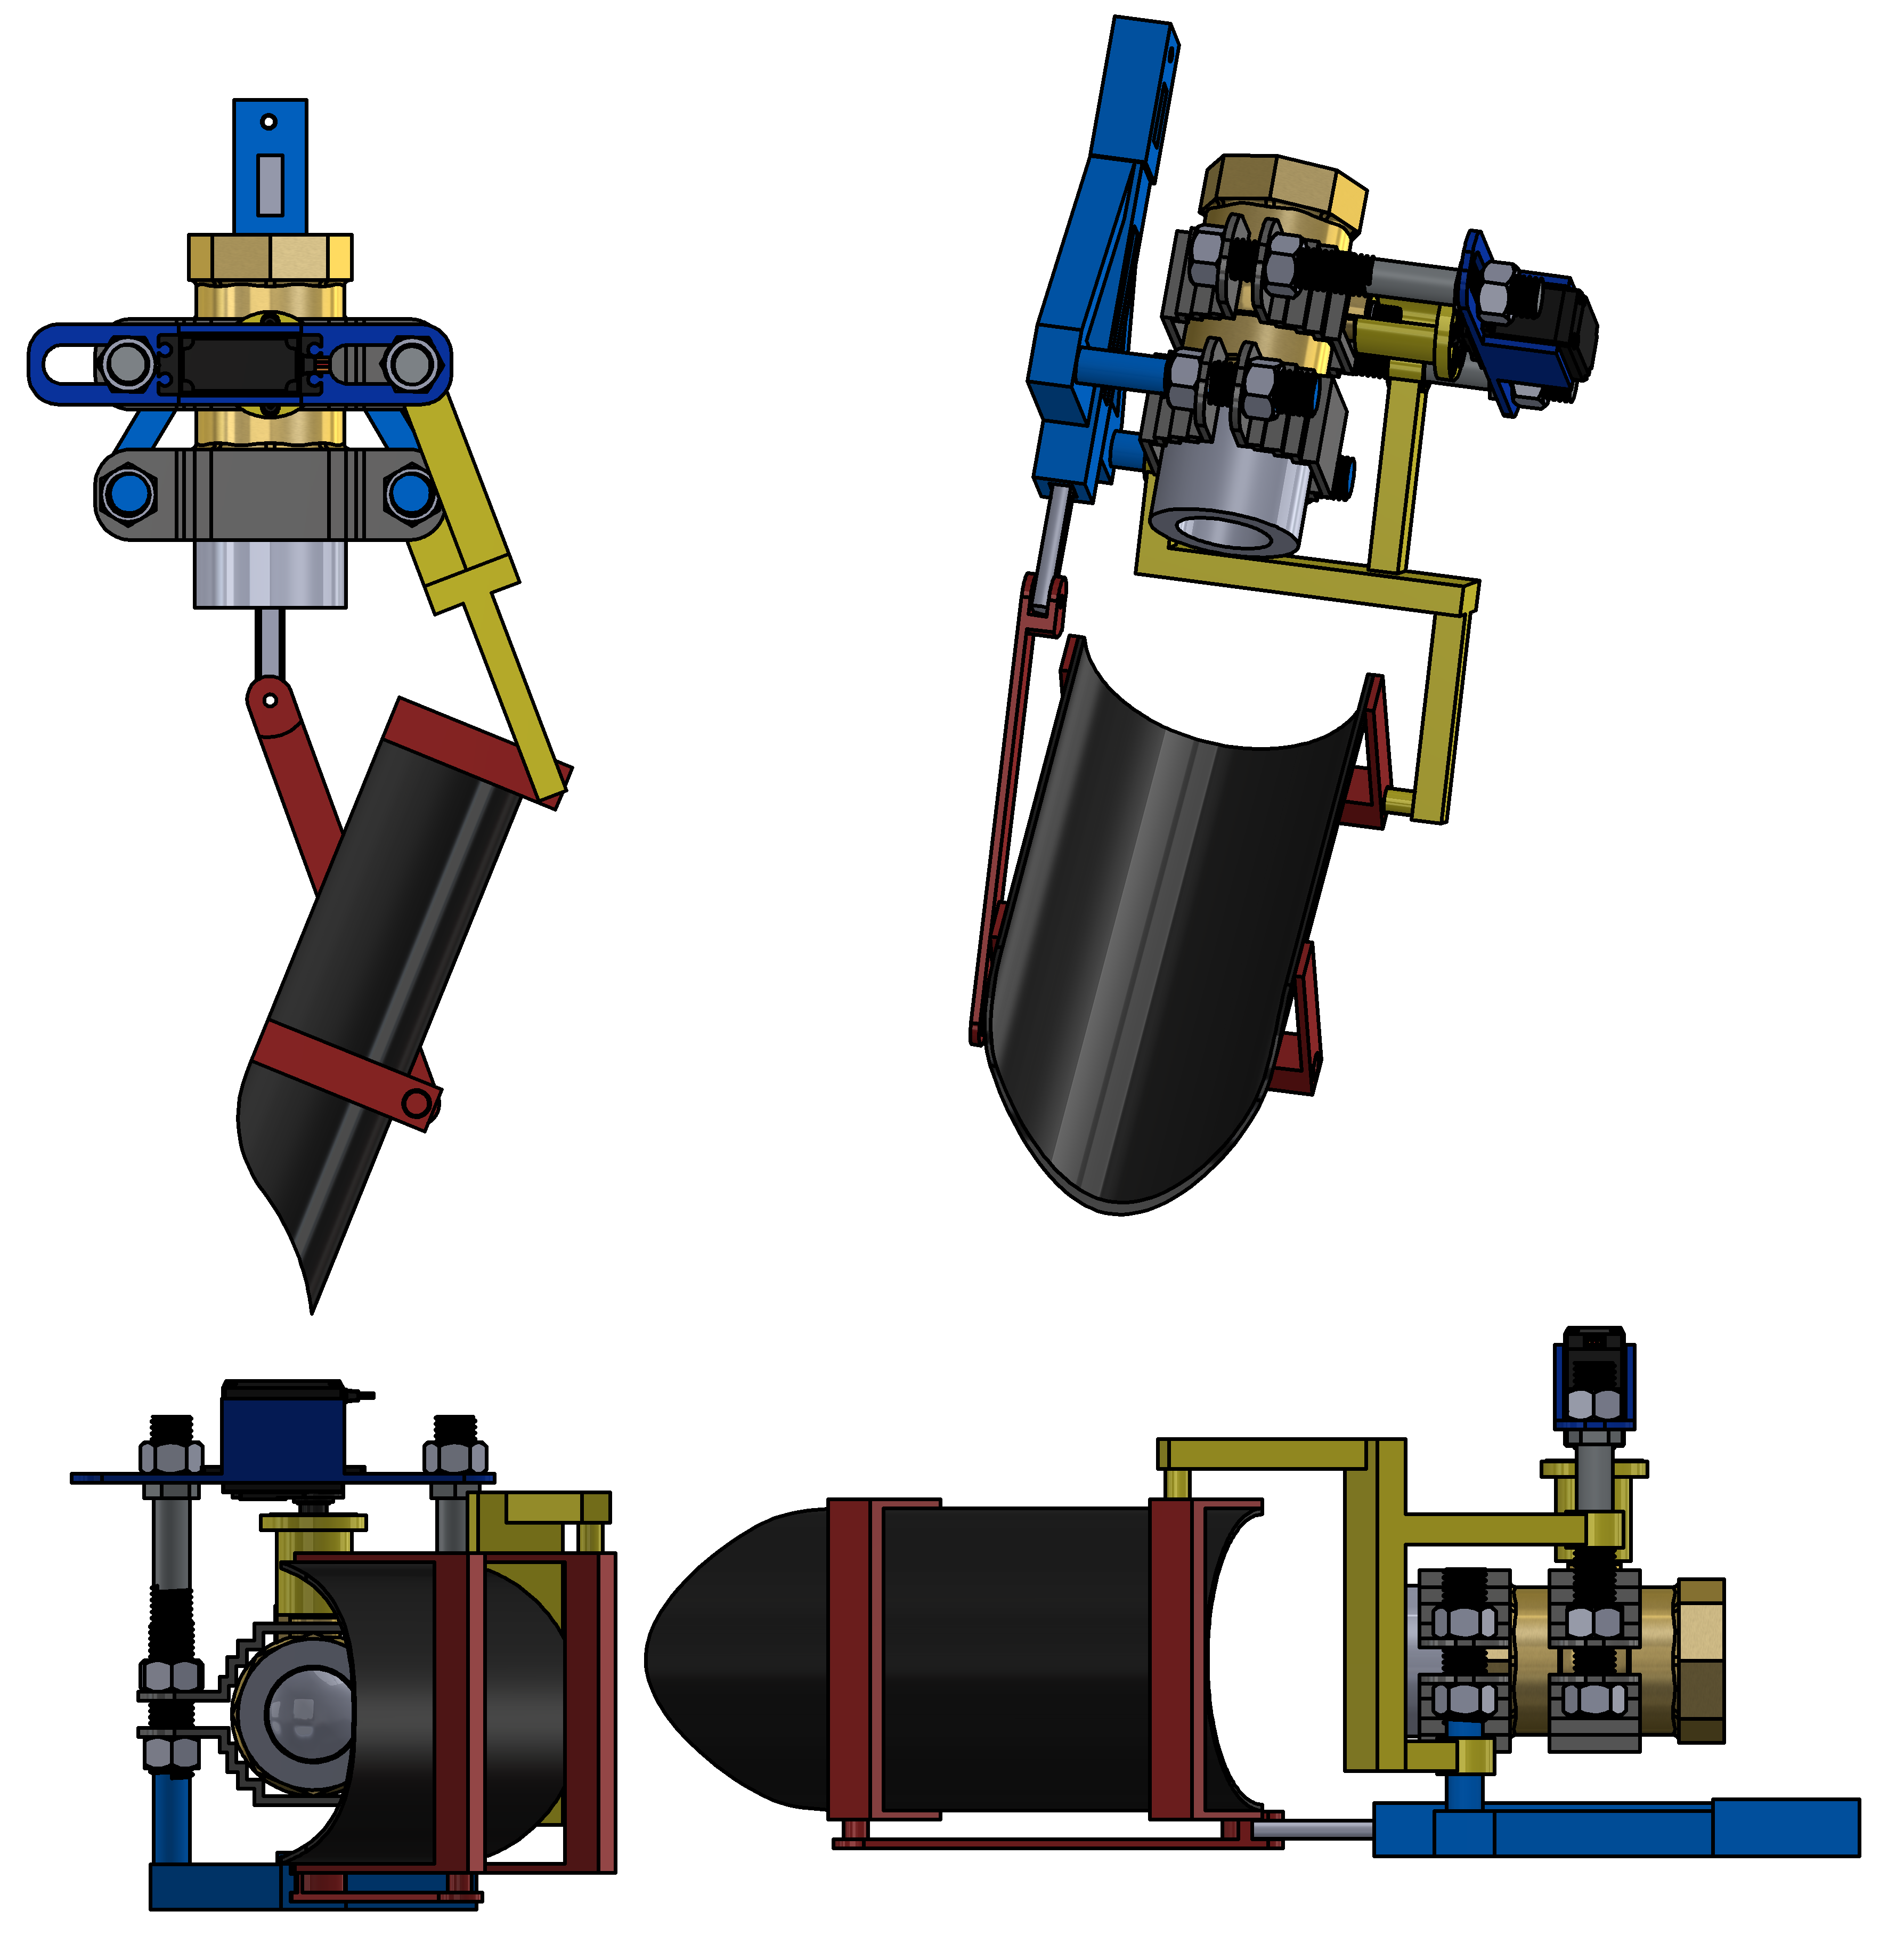
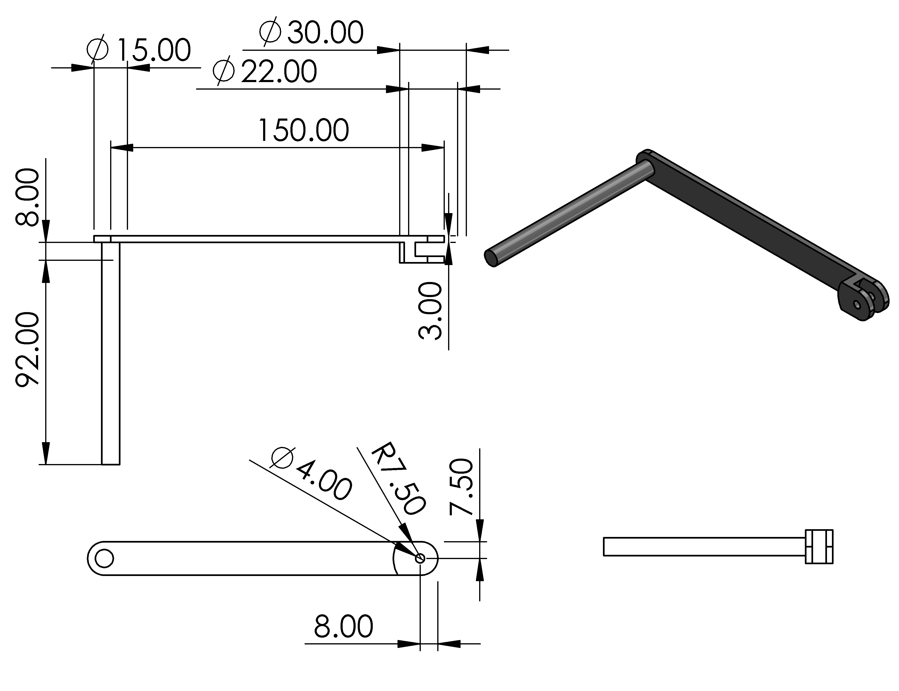
Methodology: Discharge flow control
Link

Slide 13
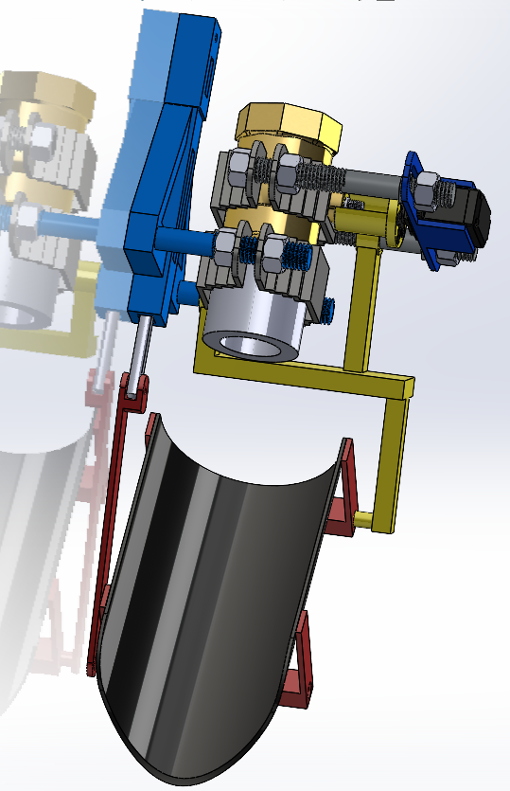
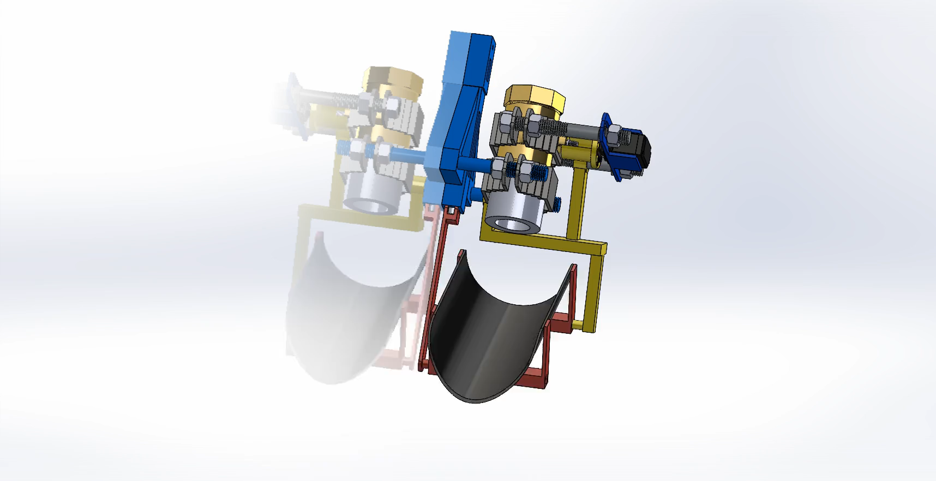
Methodology: Discharge Flow control Unit

Slide 14
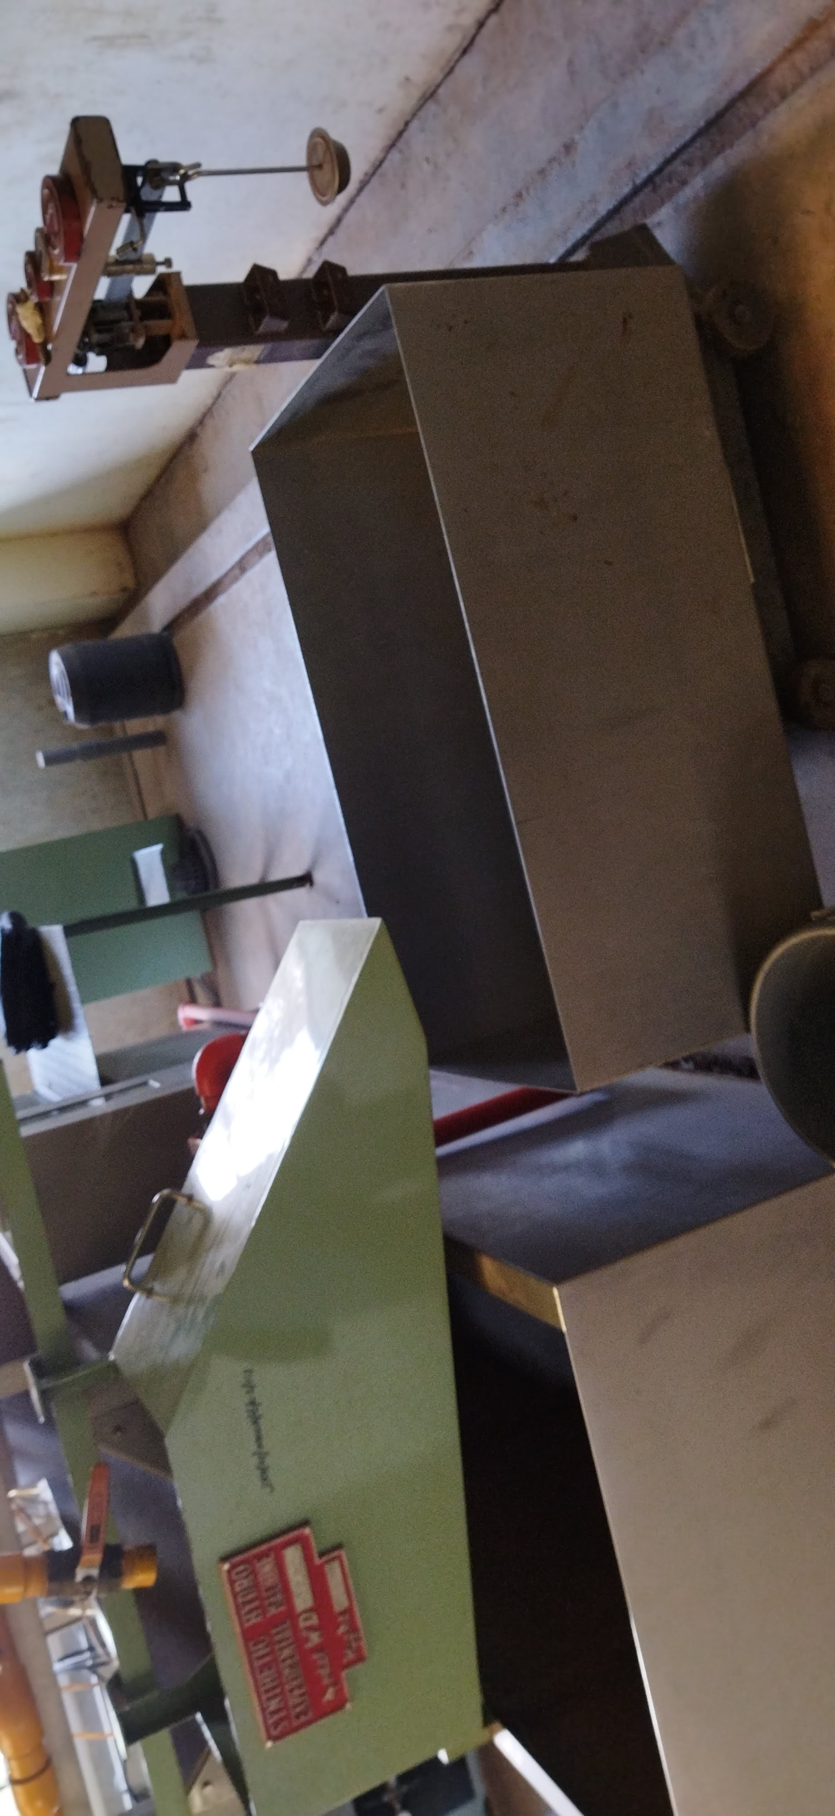
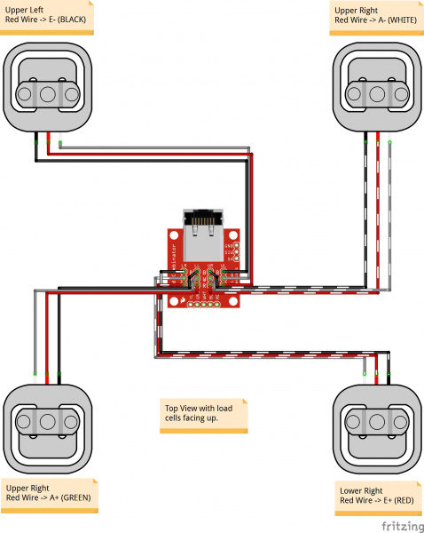


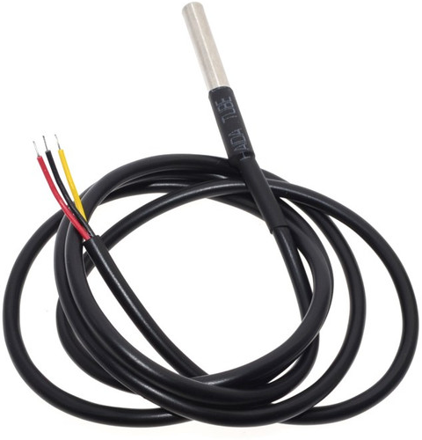
Methodology: Discharge Handling
Discharge weight measurement
Requirements:
Highest possible Sensitivity
Resolution(0-50Kg)
Credibility(forums, and experience)
Selected: Horizontal Cylindrical tank.
Justification
Motivated discharge
Easier to fabricate
1. Discharge collection tank.
Requirements: - Motivated discharge
- Capacity of not less than 20 Liters.
Selected:
50Kg strain-type load cells
Considerations
Discharge temperature measurement.
Requirements:
Highest possible Sensitivity
Resolution(0-40)
Selected: DS18B20 waterproof temperature

Slide 15
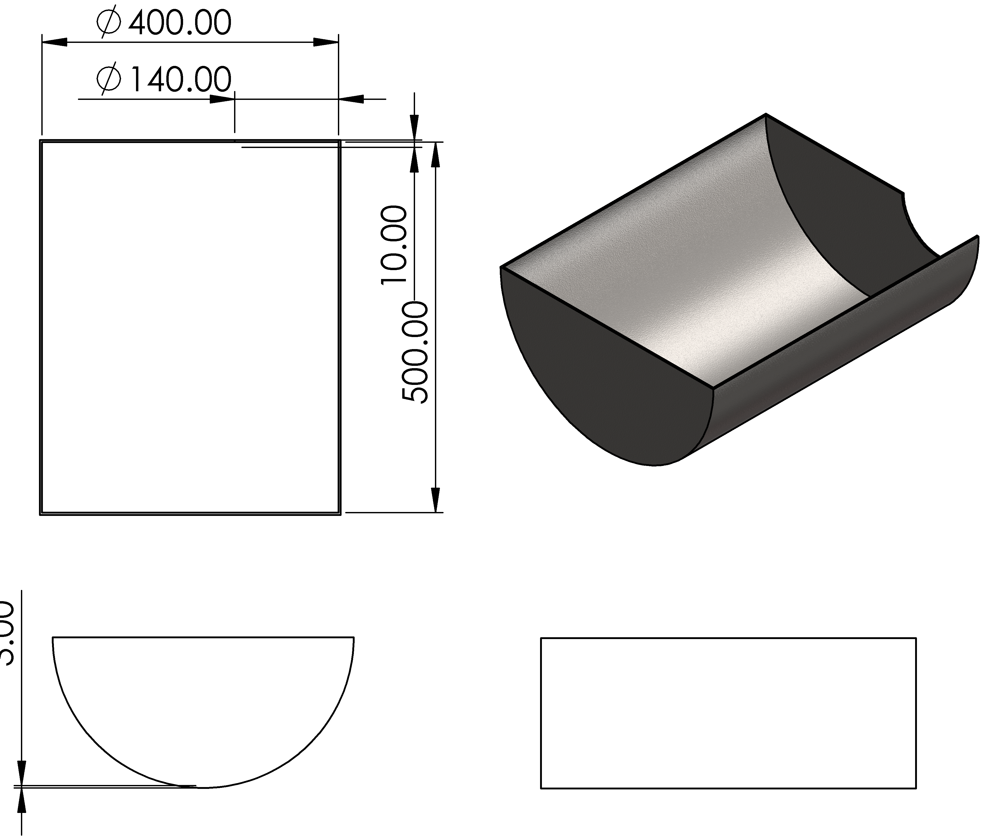
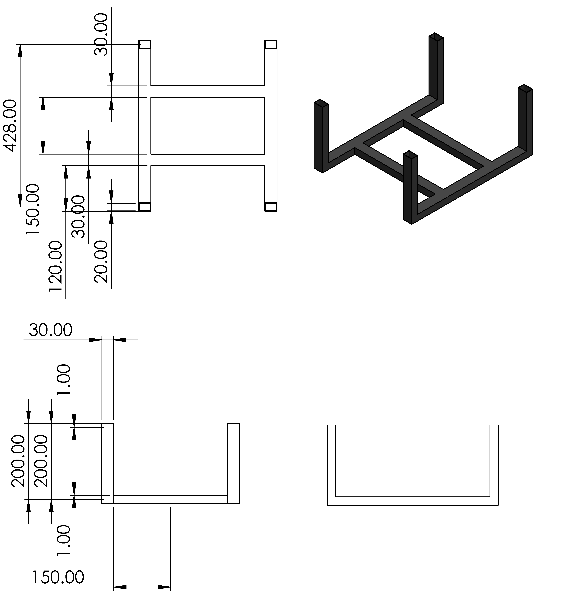
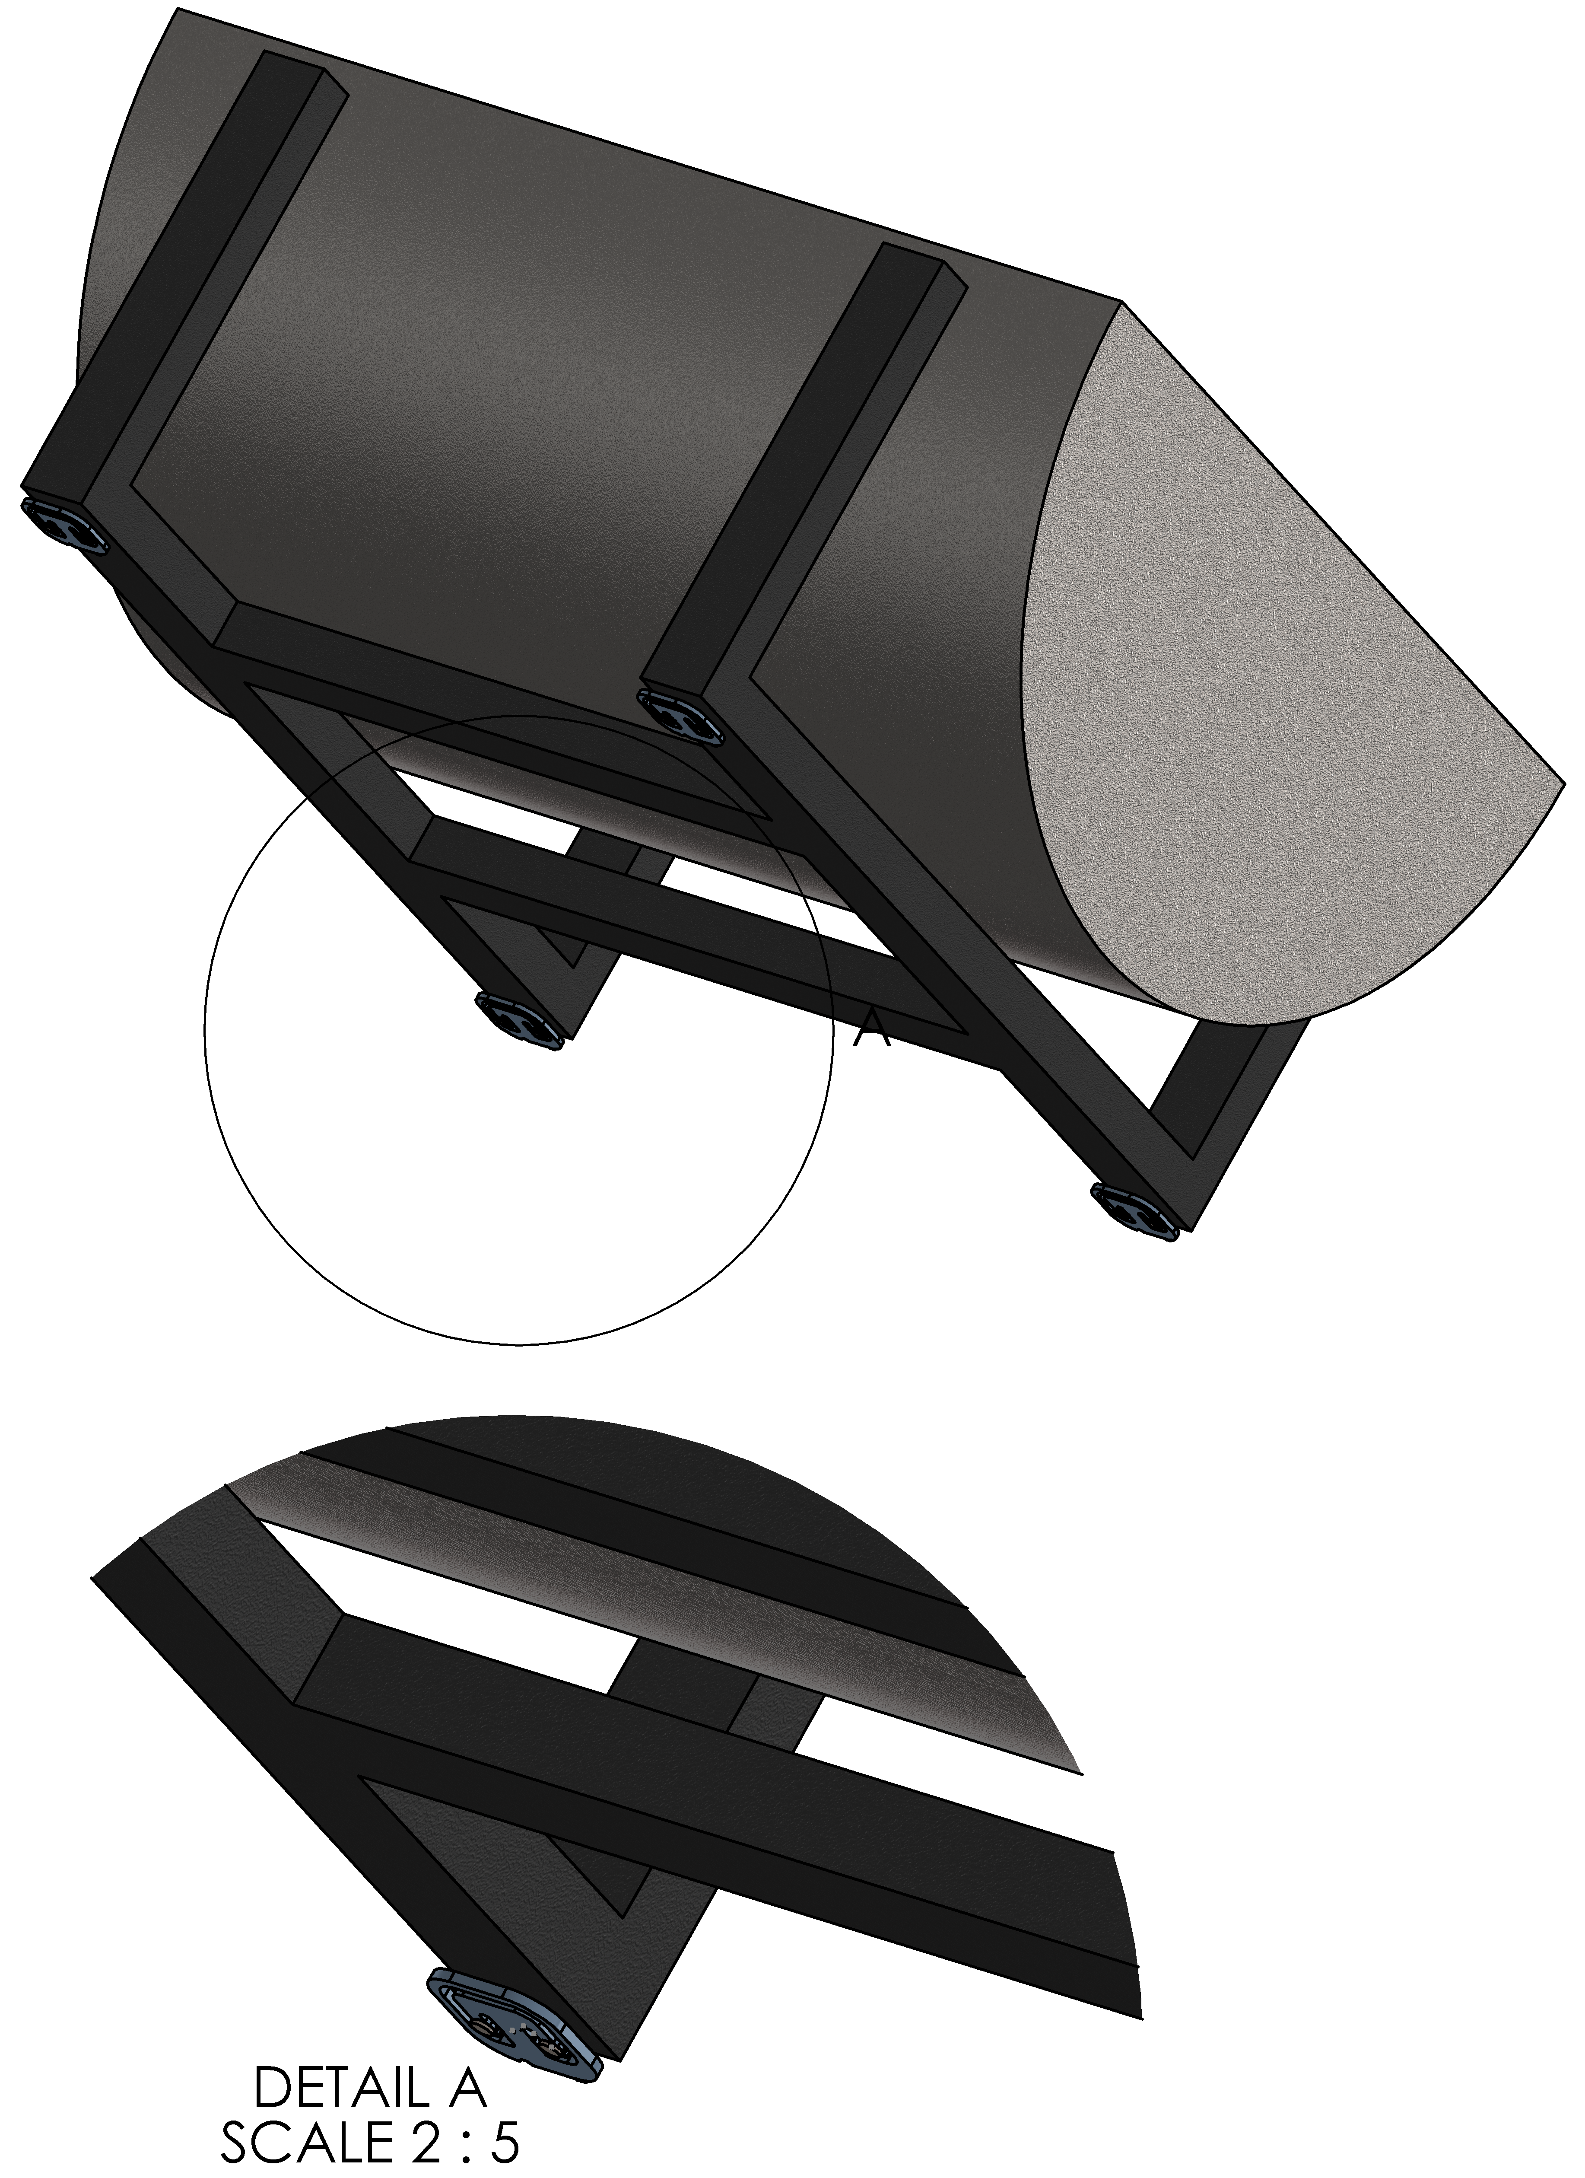
Methodology: Discharge Handling

Slide 16
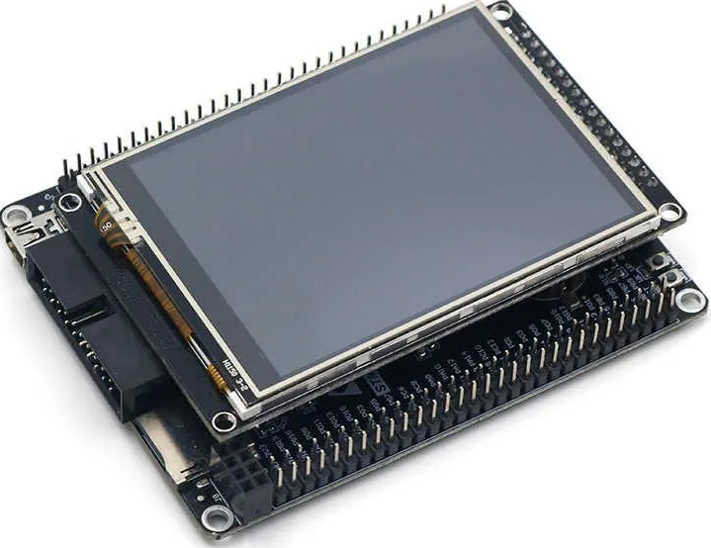
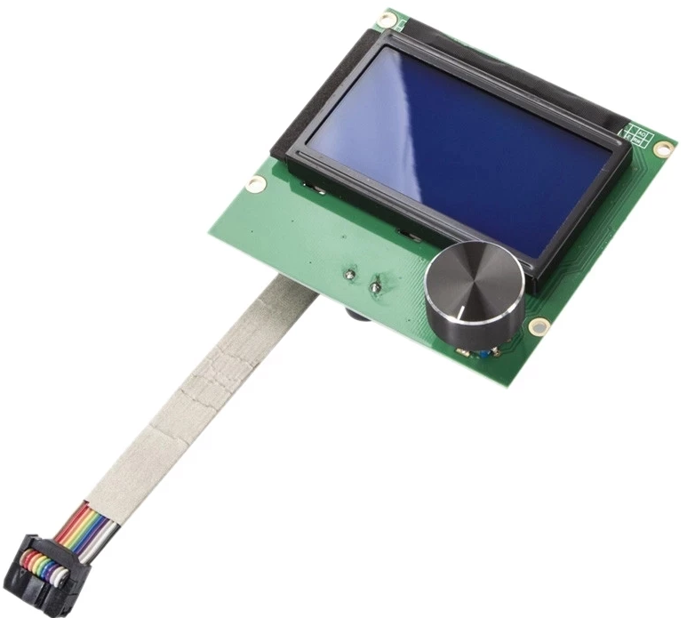
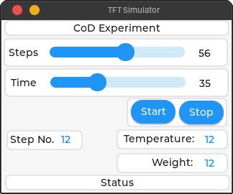
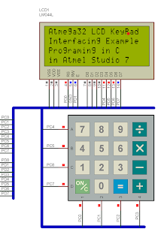
Methodology: Interface and Software
Black_F407VE + Touch LCD
Interface
Requirements: - Inputs: Step and time interval
- Outputs: Temperature and weight
- Aesthetics
Considerations
Board Selection
Drive LCD(ILI9341 driver)
Graphics library(LVGL)
LVGL + RTOS platform(peripherals)
Mbed RTOS platform selected.
Supported boards + LCD
STM32F4 family and NXP
STM32F407VET6 is cheaper
LCD+Knob
LCD+Keypad

Slide 17
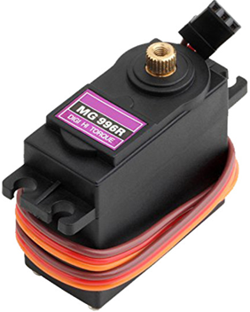
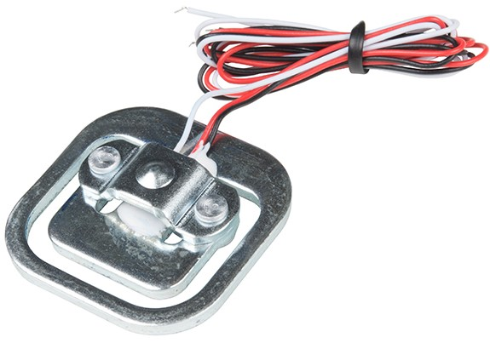
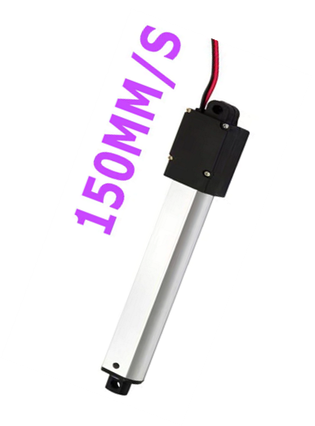
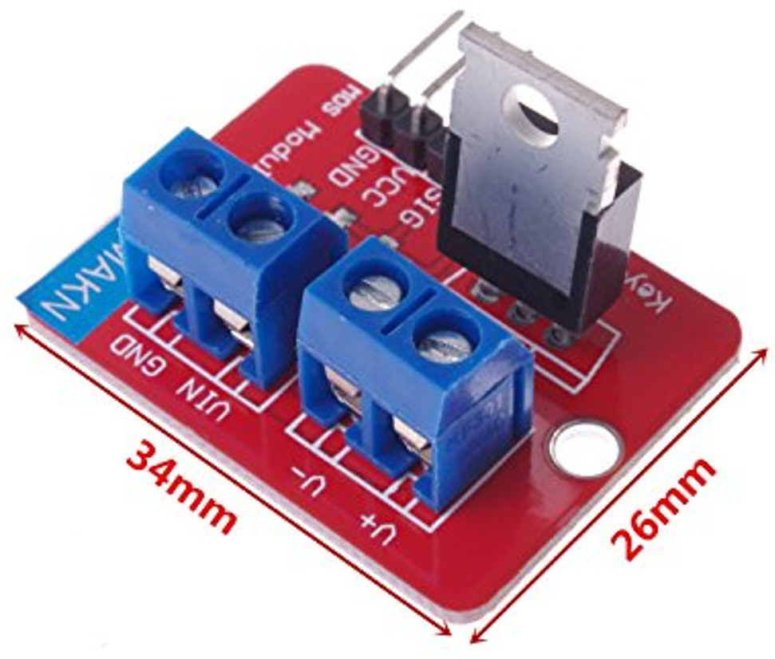
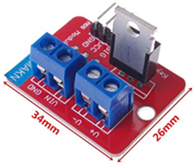
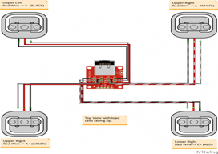
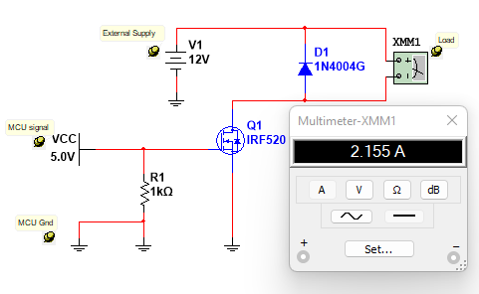
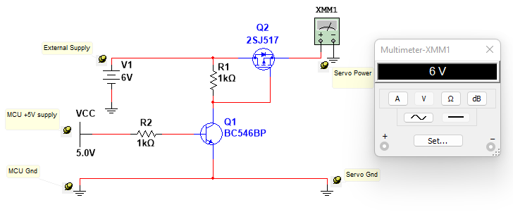
Methodology: Electrical
P16-S Micro-linear actuator
MG996R Servo motor
50Kg Strain-type load cells

Slide 18
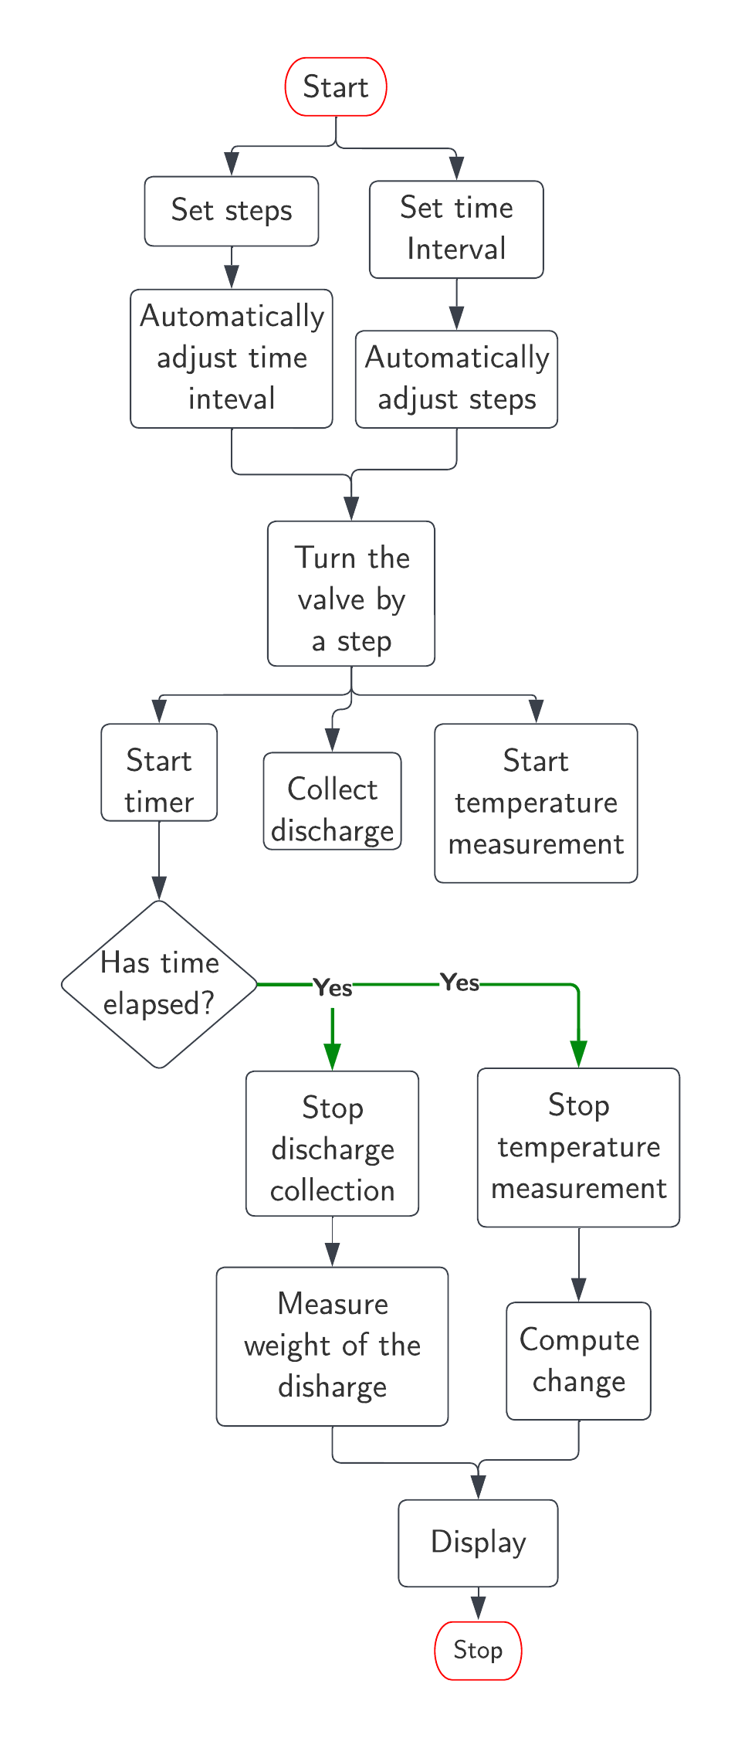
Methodology: Control

Slide 19
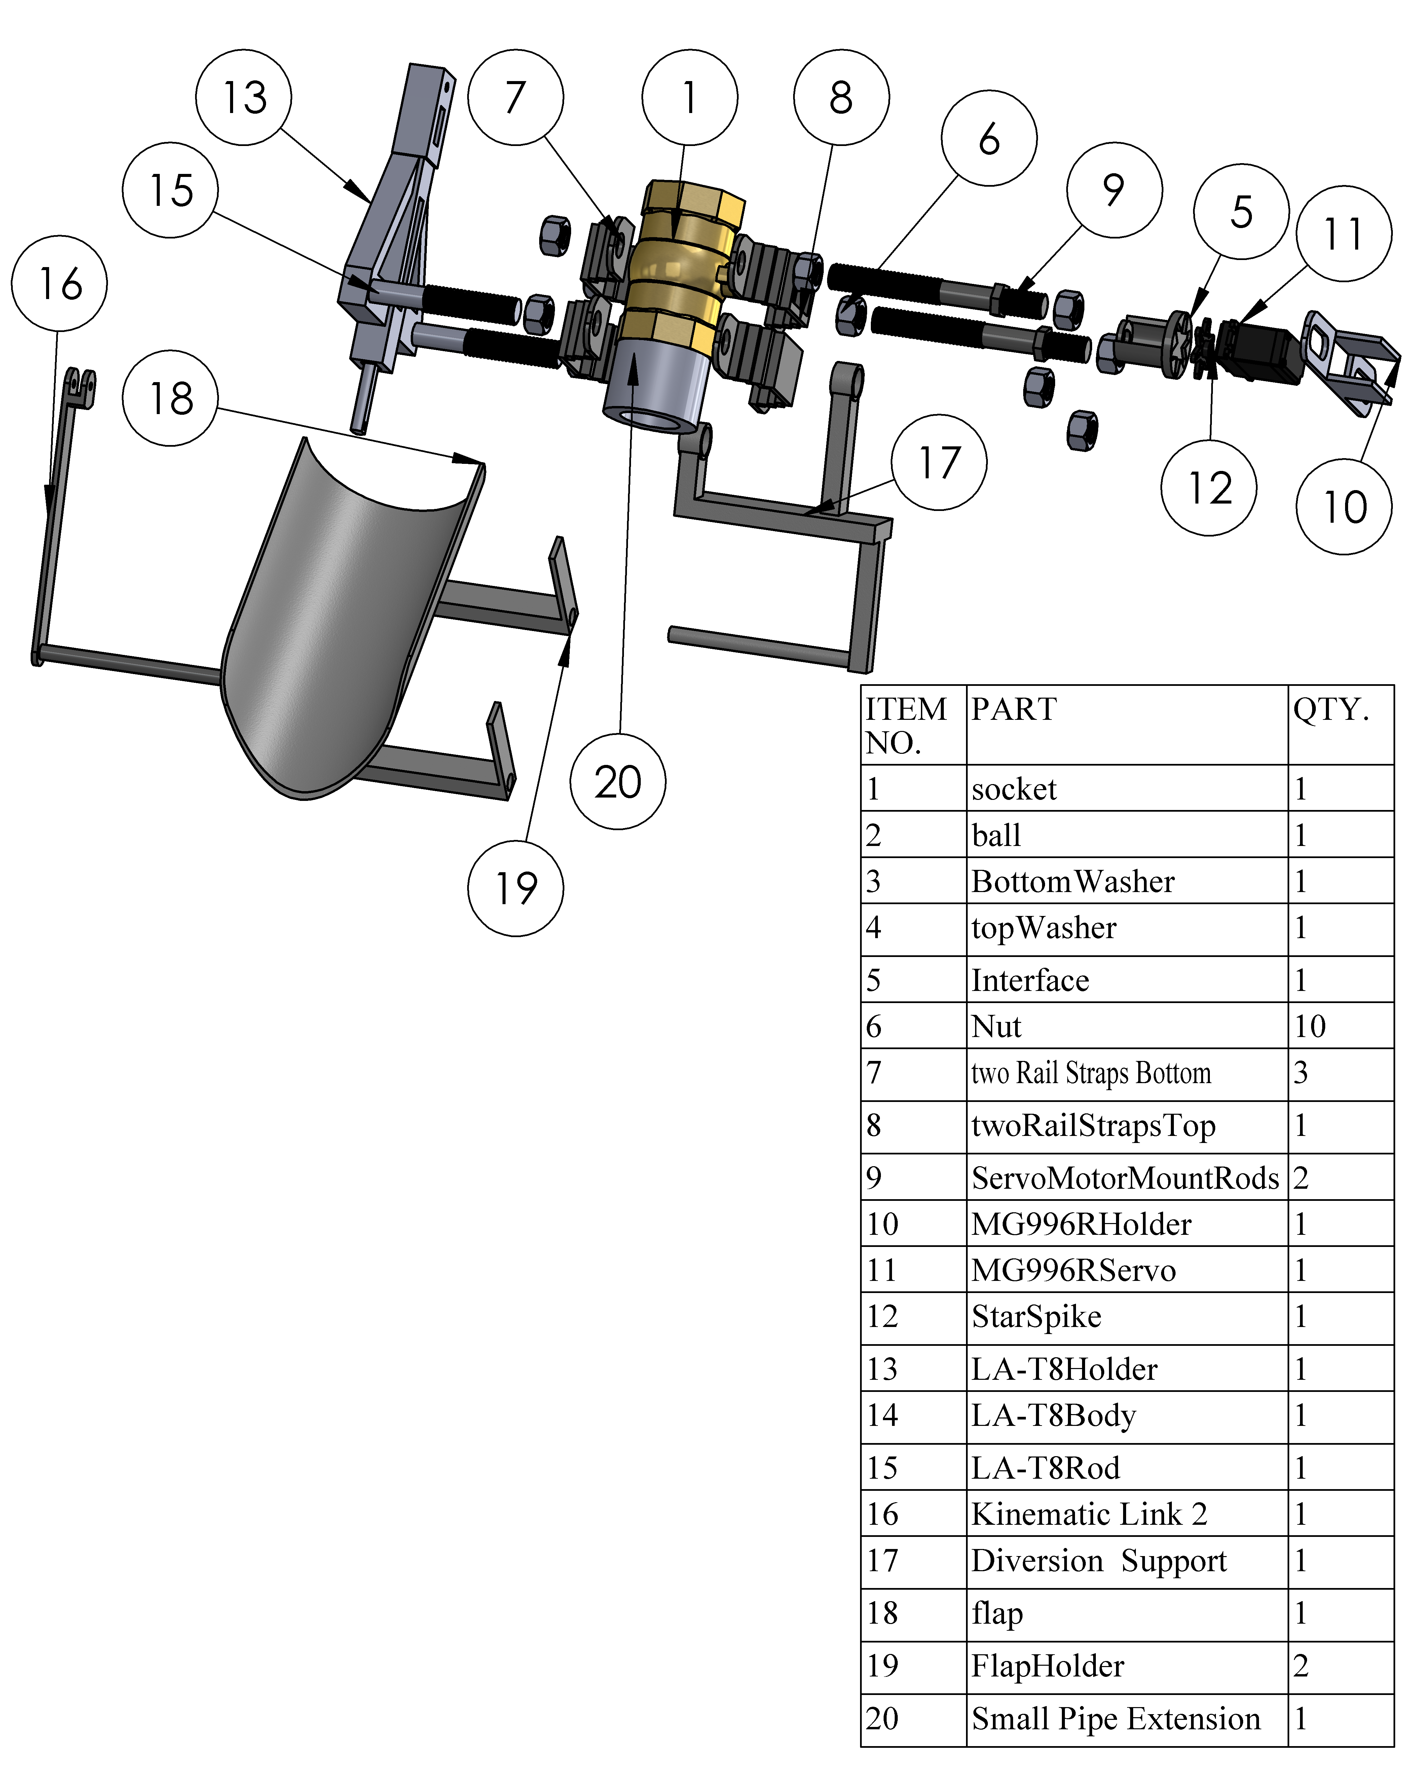
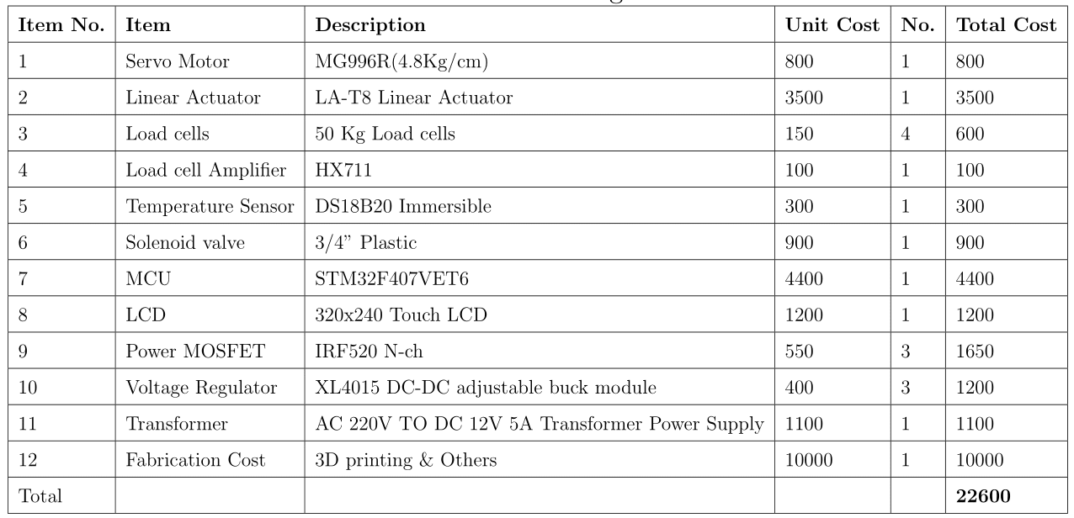
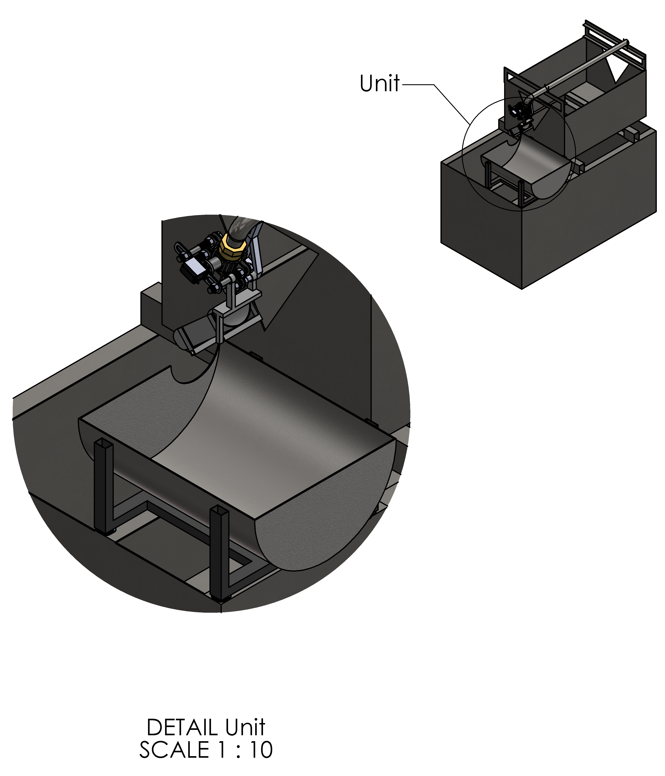
Results

Slide 20


